Slide 1
Web Development
Mr. D

Slide 2
What is a Web Page?
A page you can view in a web browser!
Web Browsers are what let you “surf the web”
  Microsoft Edge, Google Chrome, FireFox, …
See a website through “www.google.com”
… But how do I make my own web page

Slide 3
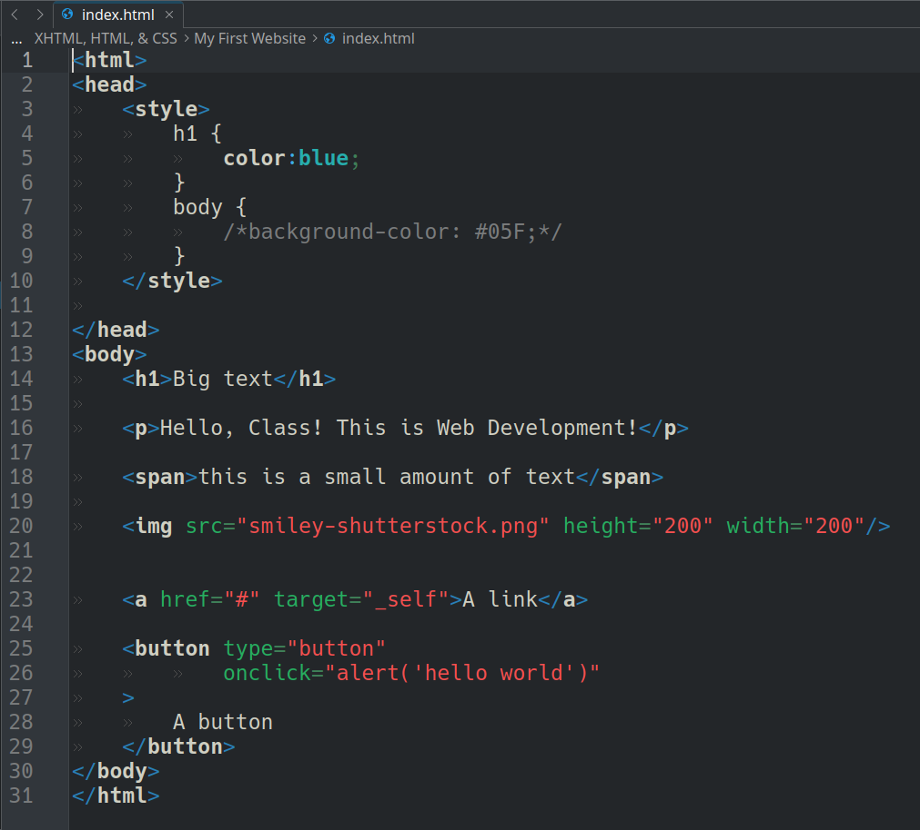
Web Page Files
HTML Files tell the browser...
  Where items show on a page
  What things to also load in the web page.
What You Type is What You See!

Slide 4
HTML Files
HTML files contain “tags”
<html></html>
Tags are special instructions for the browser
Many different tags!
  html, head, body, div, h1, nav, span, a, br, hr, button, progress, section, iframe, style, title, ol, ul, li, table, tr, td, textarea, input, select, form, option, b, i, pre, code, cite, address, strong, weak, tt, p, blockquote, ...

Slide 5
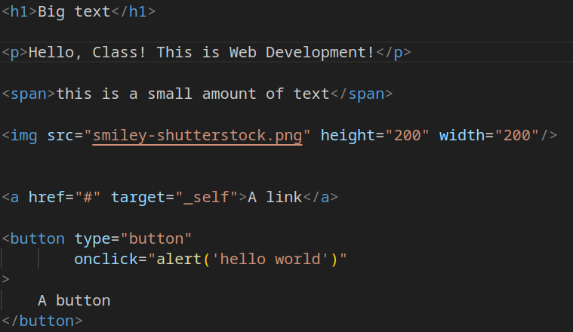
HTML basics
<h1> → heading
<span> → text
<img> → image
<div> → box to organize things
<p> → paragraph
<button> → button

Slide 6
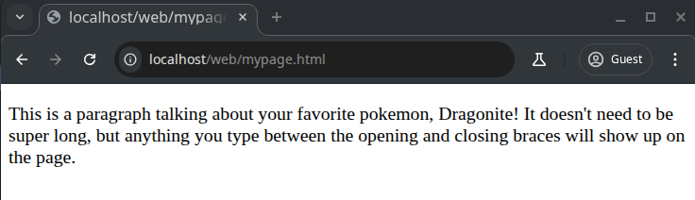
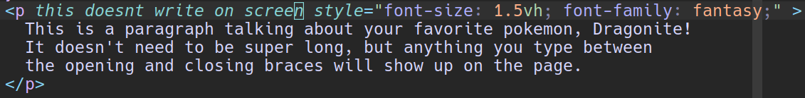
What can you do with HTML tags?
Text between the tags shows on your webpage!
<p>
  Opening tag
</p>
  Closing tag

